Slide 1
128K x 8 CMOS Static RAM
Under the guidance of Dr. Kaushik Saha

Slide 2
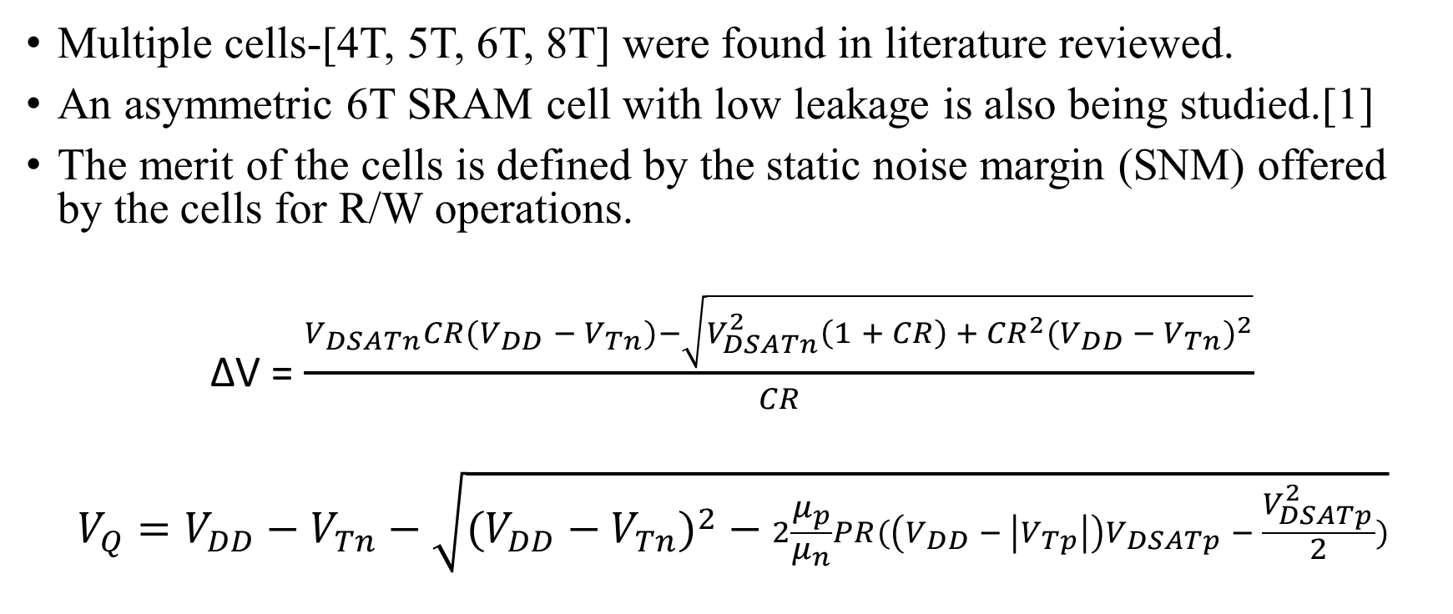
The SRAM Cell
Multiple cells-[4T, 5T, 6T, 8T] were found in literature reviewed.
An asymmetric 6T SRAM cell with low leakage is also being studied.[1]
The merit of the cells is defined by the static noise margin (SNM) offered by the cells for R/W operations.
∆V =

Slide 3
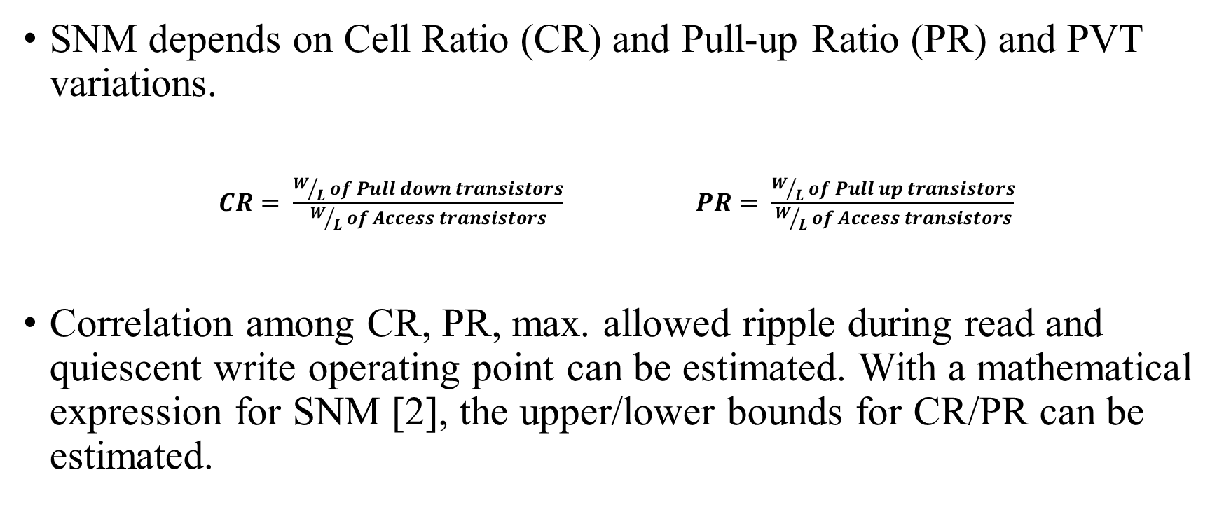
Contd.
SNM depends on Cell Ratio (CR) and Pull-up Ratio (PR) and PVT variations.
Correlation among CR, PR, max. allowed ripple during read and quiescent write operating point can be estimated. With a mathematical expression for SNM [2], the upper/lower bounds for CR/PR can be estimated.

Slide 4
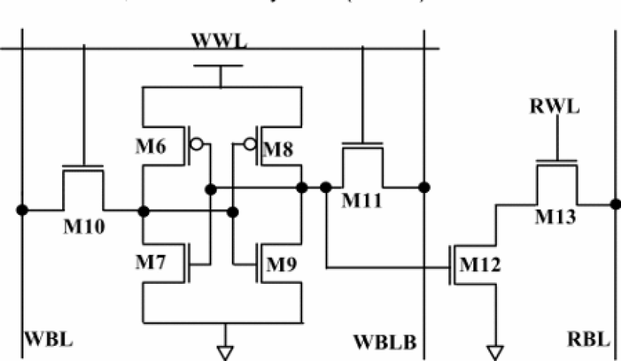
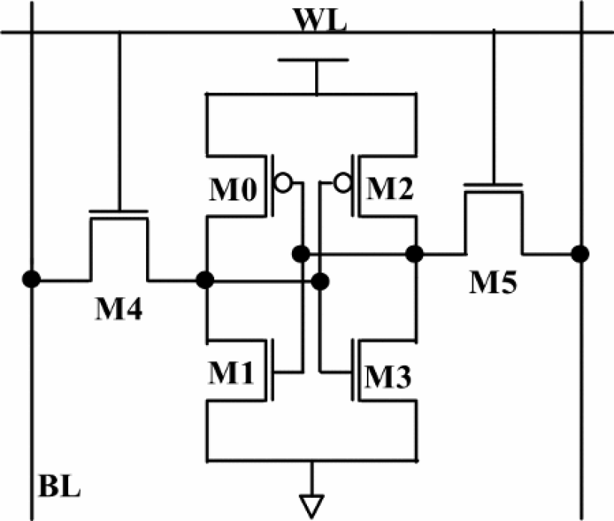
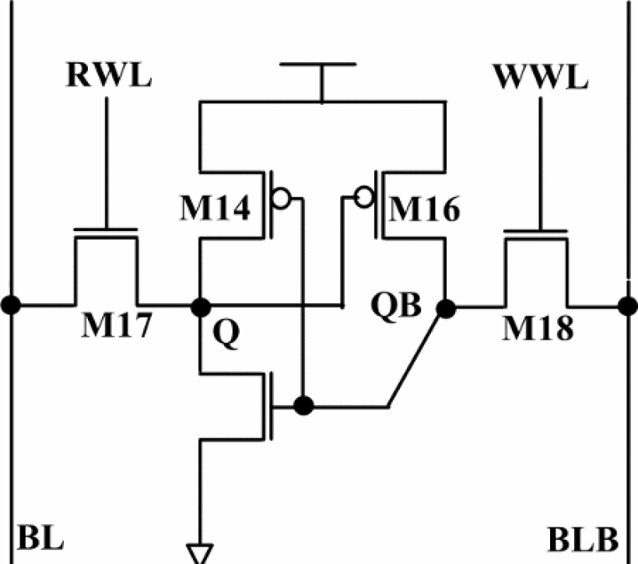
SRAM Cell topologies
(a)
(b)
(c)
Fig. 1 SRAM Cell Topologies a) 8T Cell b) 6T Cell c) 5T Cell
Ref. Anupreet Gupta, Hajra Anwer, B.S. Reniwal, S.K. Vishvakarma “Analysis of Stability Issues and Power Efficiency of Symmetric and Asymmetric Low Power Nanoscaled SRAM cells,” presented at the 2nd International Conference on Devices, Circuits and Systems (ICDCS), 2016.

Slide 5
Comparison of different of SRAM cells
Parameters | 5T Cell | 6T Cell | 8T Cell
RSNM (mV) | 202.8 | 135.5 | 340.9
WSNM (mV) | 380.7 | 347.5 | 346.4
HSNM (mV) | 300.4 | 311.2 | 312.3
Read Power(uW) | 9.4 | 17.2 | 9.3
Write Power(nW) | 39.2 | 39.1 | 39.3
Static Power(nW) | 0.21865 | 5529.77 | 5529.8
Ref. Anupreet Gupta, Hajra Anwer, B.S. Reniwal, S.K. Vishvakarma “Analysis of Stability Issues and Power Efficiency of Symmetric and Asymmetric Low Power Nanoscaled SRAM cells,” presented at the 2nd International Conference on Devices, Circuits and Systems (ICDCS), 2016.

Slide 6
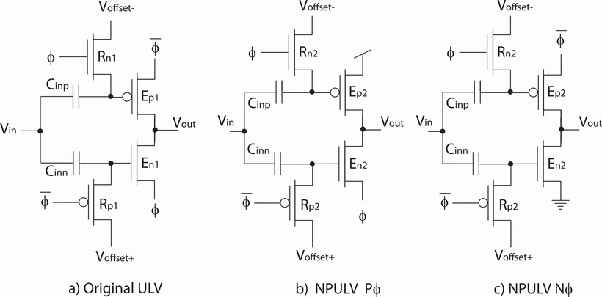
Pre-charge logic
Circuit implementations of different kinds were found.
A simple static version and a complete CMOS dynamic logic implemented version were studied. [3]
Fig. 2 Dynamic ultra low-voltage domino inverters. Original ULV (ULV1) and NP domino (ULV2) inverters. b) Pre-charge to 1 when φ = 1 and c) Pre-charge to 0 when φ = 1

Slide 7
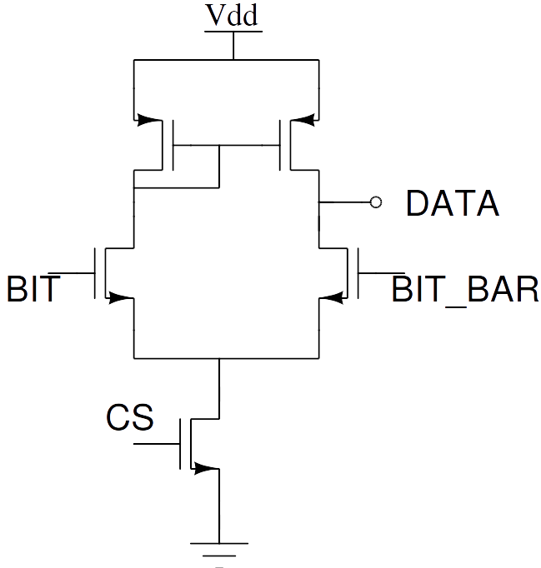
Sense amplifier
Sense amplifiers are basically differential amplifiers with high CMRR and can have a low gain of about 10.
There are multiple topologies which can be used to make a sense amplifiers which were studied.
A simple dual input single ended output differential amplifier can be used for this purpose.
Fig 3. dual input single ended output differential amplifier

Slide 8
Contd.
A different approach is to use two inverters tied back to back .
An interesting fact about sense amplifiers is that we are not limited on the output voltage swing[4]

Slide 9
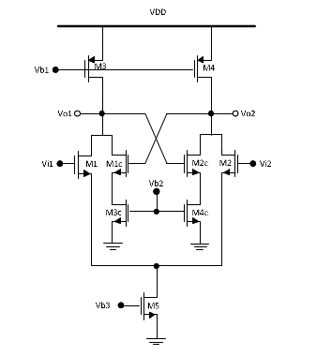
Contd.
This property can be exploited by using a positive feedback network incorporated in a classical analog differential amplifier.
Such a network was studied which used a cross coupled pair as a regenerating circuit.
Spice simulation of these three shortlisted candidates for making the sense amplifiers are to be carried out and the final decision is to be made based on the simulation results.[5]

Slide 10
References
[1] “Low-Leakage asymmetric SRAM Cell”, Azizi et.al. IEEE TVLSI vol.11 no.-4, 2003.
[2] “Static noise margin analysis of SRAM cell”; Seevnick et.al. IEEE JSSC vol.-22 no.-5, 1987.
[3] “Robust low power CMOS Precharge Logic”, Berg et.al. IEEE 2013.
[4] Rabaey, Chandrakasan and Nikolic, “Designing Memory Array Structures” in Digital Integrated Circuits a Design Perspective, 2nd ed.,vol. 1. Noida, Pearson India, 2016, pp. 657-662.
[5] “Gain-Enhancement Differential Amplifier Using Positive Feedback”, Phuoc T. Tran et. al. in MWSCAS, IEEE, 2012.

